Slide 1



Motion and Fire Detection System Using Cameras
Final Year Project
Suryansh Choudhary

Slide 2
Agenda
Introduction
Motion Detection
Fire Detection
Applications
Conclusion

Slide 3

Introduction
The project aims to demonstrate the potential of computer vision technology in practical applications, specifically in security and safety.
The project is a combination of two individual projects:
Motion Detection System
Fire Detection System
We have executed the projects using OpenCV and webcam.
Motion Detection System uses the concept of Absolute Differencing to detect motion.
Fire Detection System uses the HAAR Cascade file to detect the instances of motion.

Slide 4

Motion Detection System

Slide 5
Methodology
Capture the webcam’s live video feed
OpenCV VideoCapture() function captures the webcam’s video feed. The function inputs the device index or the video file’s name. The video stream is then read frame by frame using the read() function.
Preprocessing the frames
We begin by rescaling frames to 1000 pixels wide. The colored frames are then converted to grayscale, as color doesn’t affect motion detection. We will apply Gaussian blurring to our photos to smooth them.
Average out the recent frames
The recent frames are averaged out using the accumulateWeighted() function in OpenCV, which is used to create a running average of the recent frames. The input frame’s weight determines its contribution to the output frame.
Absolute Differencing
The current frame is subtracted from the average of the recent frames using the absdiff() function in OpenCV. The result is a grayscale image with pixel values representing the absolute difference between the frames.

Slide 6
Methodology
Threshold the difference image
Find the contours in the thresholded image
The contours in the thresholded image are found using OpenCV’s findContours() function. The function takes the input image and the contour retrieval mode as input.
Send notification to the Telegram bot
A Telegram bot is notified if the project detects motion in the video stream. The notification comprises the time and date of motion and an image.
Transfer the data to a CSV file
The project uses the CSV module available in Python to write the motion’s date and start and end time to a CSV file. The CSV file works as a log for the motion detection events.
The difference image is thresholded using the threshold() function in OpenCV. We set the pixel value to 255 if the value is above the min threshold & 0 otherwise. The threshold value is selected based on the sensitivity of the motion detection.

Slide 7
Result
The model can determine whether or not there is motion in the room.
Additionally, the model produces a beeping buzzer sound at each incidence of the move.
After the execution of the model has been finished, a CSV file will be created with the name “Security_Log.” The CSV file possesses the dates, as well as the start and end times, of the motion instances.
Alerts are sent out to Telegram Bot immediately upon the first instance of motion and after 5 minutes if more activity has occurred.
Result of the Model
Threshold Image
Frame Delta Image

Slide 8
Result
Security Log CSV File
Telegram Notification

Slide 9
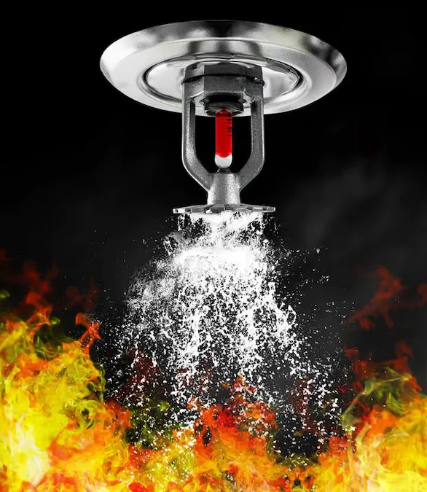
Fire Detection System

Slide 10
Methodology
Capture the webcam’s live video feed
OpenCV VideoCapture() function captures the webcam’s video feed. The function inputs the video file’s name. The video stream is then read frame by frame using the read() function.
Preprocessing the frames
We begin by rescaling frames to 1000 pixels wide. The colored frames are then converted to grayscale, as color doesn’t affect motion detection.
Preparing the HAAR Cascade file
A pre-installed HAAR Cascade file is used for fire detection. The HAAR Cascade file is a set of classifiers that can be trained to detect specific features in an image.
Detecting Fire
To detect fires, we utilize cv2.CascadeClassifier.detectMultiScale(). If flames are detected, the function returns the coordinates of detected fires as Rect(x,y,w,h).

Slide 11
Methodology
Drawing Bounding Boxes
Initializing Alarm
The Windows platform serves as the system’s speaker and plays a buzzer when a fire occurs. The Beep(frequency, duration) function beeps the computer’s speaker.
Send notification to the Telegram bot
A Telegram bot is notified if the project detects fire in the video stream. The notification comprises the time and date of the fire and an image.
Once the fire is detected through the HAAR Cascade Classifier, we extract the coordinates and start a loop to draw the bounding boxes in the region of the fire detected. The cv2.rectangle() function is used to create a bounding box.

Slide 12
Result
The model can detect whether or not there is a fire in the room.
Whenever there is a fire, the model will make a buzzing beeping sound.
The notification system will send notifications to a telegram bot with the fire’s date, time, and image.
Result of the Model
Telegram Notification

Slide 13

Applications
The combined project, which integrates motion detection and fire detection using computer vision technology, has several practical applications in security and safety.
Home security
Workplace safety
Industrial safety
Public safety
The system can be used for home security, detecting any instances of motion or fire in the home and triggering real-time notifications to the user via the telegram bot.
The system can be used in workplaces to detect fire or unauthorized access. The real-time notifications enable the security personnel to take timely action to prevent damage or loss.
The system can be used in industries to monitor critical areas and detect any instances of fire or motion. The system can be integrated with other safety measures such as alarms, sprinklers, and evacuation plans to ensure timely response in case of any emergency.
The system can be installed in public places such as shopping malls, theaters, and airports to detect any instances of fire or unauthorized access. The system can be integrated with the existing security measures to ensure the public’s safety.

Slide 14
Conclusion
The combined project integrates motion and fire detection using computer vision technology to detect instances of motion and fire in real-time using a webcam.
When motion or fire is detected, the system sends a real-time notification to the user via a telegram with an image confirmation.
In motion detection, the system sends a follow-up notification after 5 minutes if a new motion is detected and stores the data in a CSV file that holds the date and start and end time of motion.
In case of fire detection, the system sends a follow-up notification after 10 minutes if a new instance of fire is detected.
The real-time notifications and image-based confirmation enable quick and effective responses, making it an ideal solution for ensuring the safety and security of people and property.

Slide 15






